Slide 1

CEDD AGL ISLF
Integrated
Spring-Loaded
Flags
By:
Anton Zubovskyi
Yaman Çağlar
Coen Roelofs

Slide 2


Power Failure – not enough lights for taxiing

Slide 3


CEDD AGL ISLF:
Integrated Spring-Loaded Flags

Slide 4

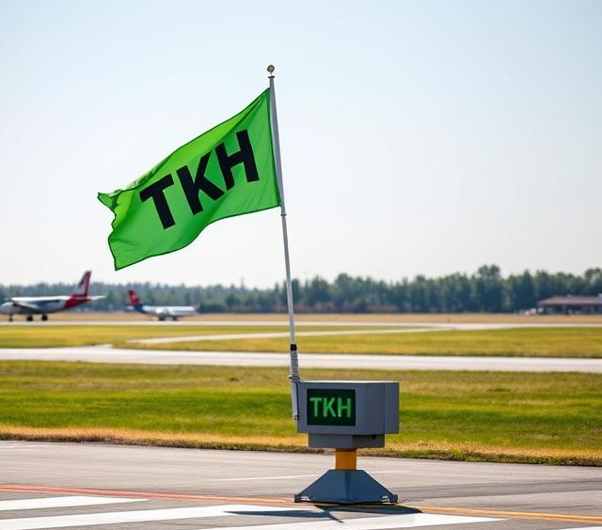

Concepts

Slide 5
Thank you
For Attention
By:
Anton Zubovskyi
Yaman Çağlar
Coen Roelofs

