Slide 1

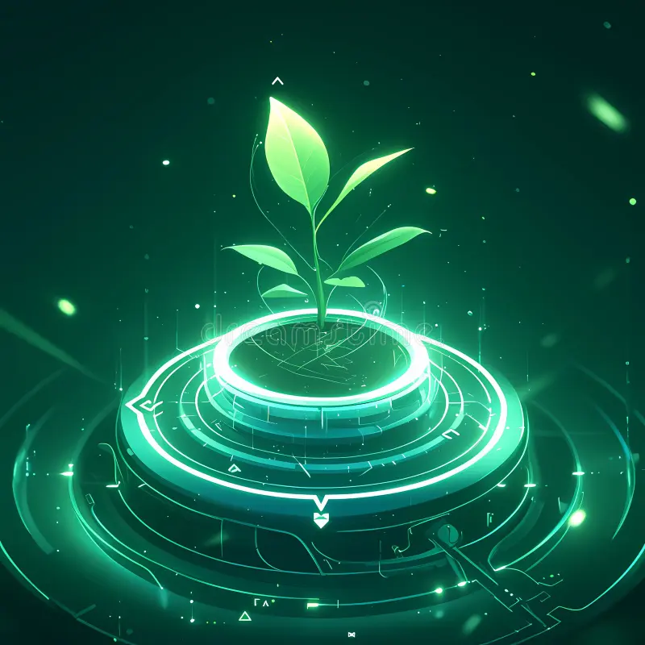
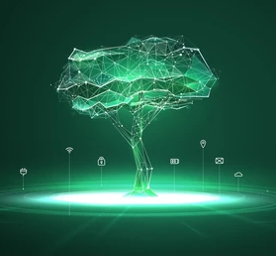
Grow Your Tree!

Slide 2


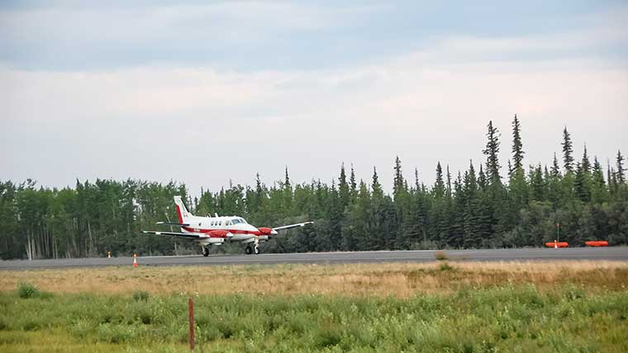



EmPloyees/Customer
Reduce your ecological footprint
Earn Points
Let your tree grow!
Bonus: Employees could earn points with self development and growth as well!

